Slide 1




Minimum Wages and Employment: A Case Study of the Fast-Food Industry in New Jersey and Pennsylvania
DAVID CARD AND ALAN B. KRUEGE (2000)
Sophie Hensgen, Tiffany Myers, Khizer Naushad, Yusang Zhang

Slide 2
Introduction
Card and Krueger’s case study focuses on the effect of minimum wage increase on employment in the fast food industry during 1992
before and after the wage increase
Location: New Jersey (NJ) and eastern Pennsylvania (PA)
April 1, 1992, NJ raised their minimum wage from $4.25 to $5.05 per hour
NJ had the highest minimum wage in the country
No clear theory applied, instead tested against predictions of Economic Theory - a rise in wages leads competitive employers to reduce the amount of their employees
Several studies with similar methodology tested this theory and results failed to show negative employment effect on higher minimum wages

Slide 3
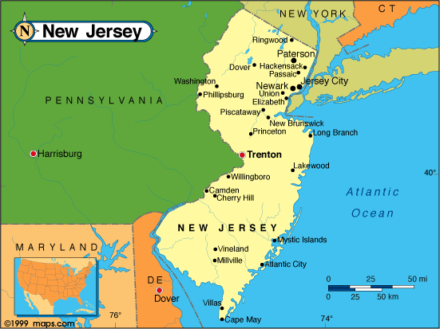
Sample Design
Sample size - 410 restaurants
Restaurants surveyed- Burger King, KFC, Wendy's, and Roy Rogers
Control group - fast food restaurants in PA
proximity and similarity to NJ
Time frame - 2 Waves in 1992
Wave 1 - before the rise in minimum wage
February to March 1992
Wave 2 - 7 to 8 months after the rise in minimum wage
November to December 1992

Slide 4
Simple use of empirical methodology
Card and Krueger’s first wave of the study was conducted by telephone interviews
Surveys consisted of questions regarding employment, starting wages, meal prices, and other characteristics of the chain restaurants
Several significant features to data set:
- Recession*
- Due to NJ size, using PA as a control group
- Successfully followed nearly 100% of stores in conducting interviews for the first wave (before the minimum wage increased) and the second wave (7-8 months after the increase)
*Card and Krueger state that legislation was passed 2 years before recession occured, although highly unlikely that the effects of the higher minimum wage were obscured by a rising tide of general economic conditions

Slide 5
Wave 2 consisted of a second round of interviews to the same 410 restaurants
Out of 410 respondents in first wave, only 371 responded in second wave (90%)
39 non respondents - store closure, temporary store closure, and renovations
Card and Krueger’s study additionally tested other factors such as:
Whether the minimum wage increase affected employment in restaurants that already had above average wages before the law was passed
If minimum wage differed between full time and part time employees
Management offset the increased wages by reducing fringe benefits.
Restaurants increased the meal prices to offset the wages

Slide 6
Main Findings
Card and Krueger find no indication of a rise in minimum wage reduces employment
Full time employment increased in NJ after the law was passed
Full time and part time had equivalent starting wages
No statistically significant evidence that managers offset the increased wages by reducing fringe benefits - NJ saw a shift towards more generous fringe benefits since the wage increase but this is not statistically significant
Found that meal prices in NJ rose 3.2% faster than in PA between the February and November 1992
provides mixed results if higher wages lead to higher meal prices
Appears that when the minimum wage increased, the consumers took the burden of offsetting the costs
Increased wages led to increased employment in NJ

Slide 7
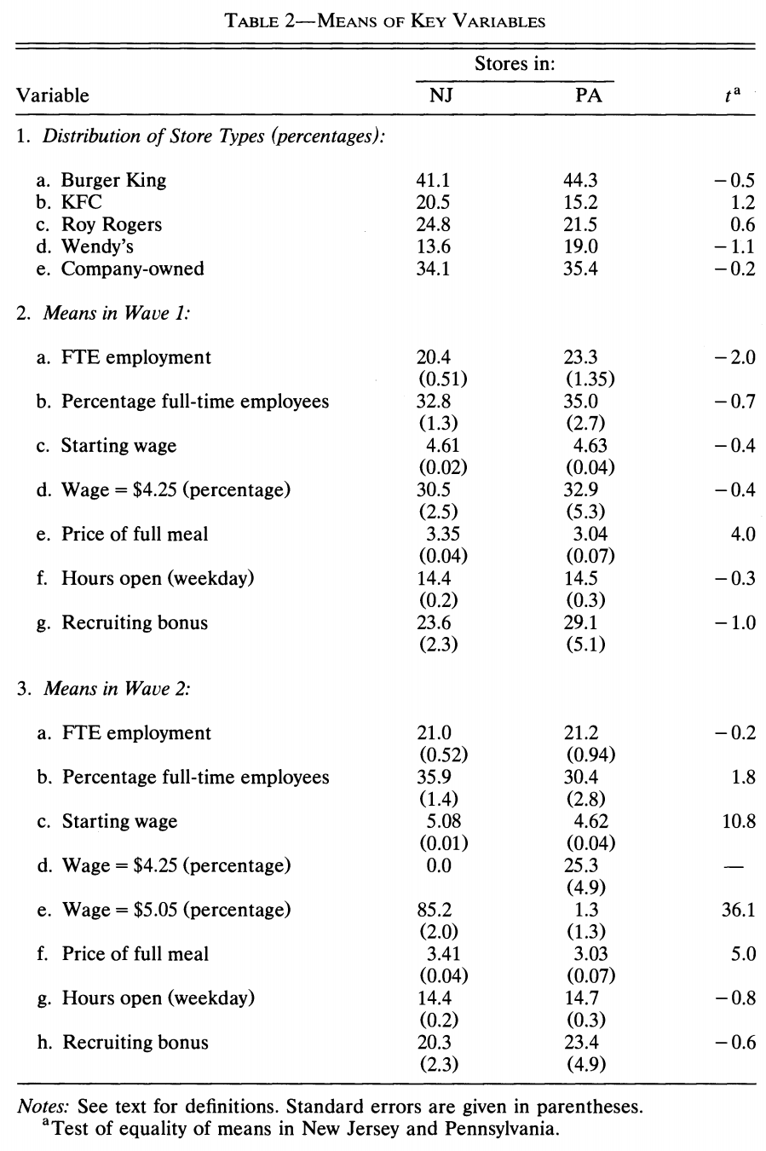
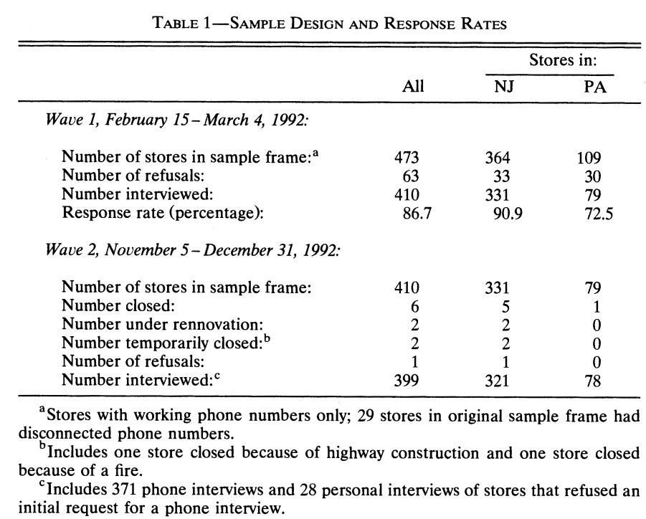
Methodology overview
Response Rate & Means of Key variables

Slide 8
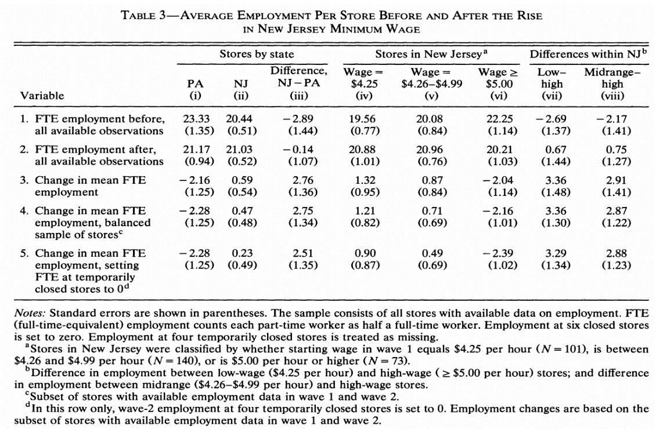
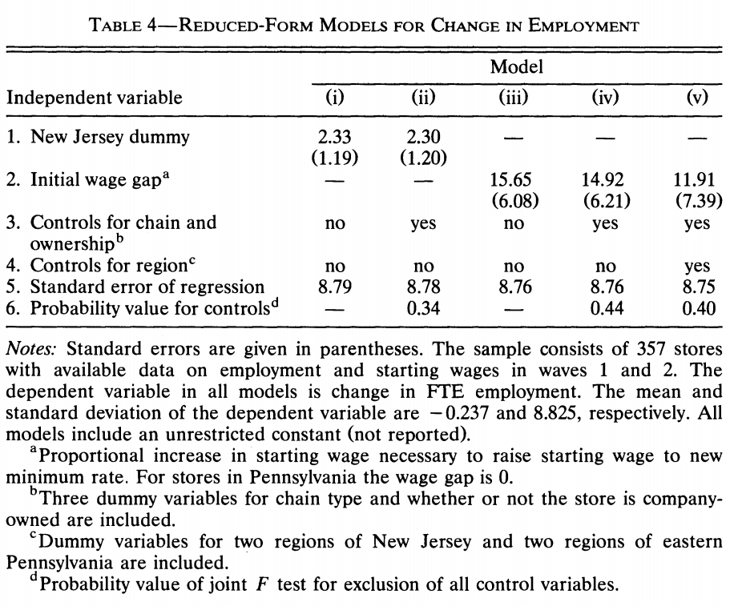
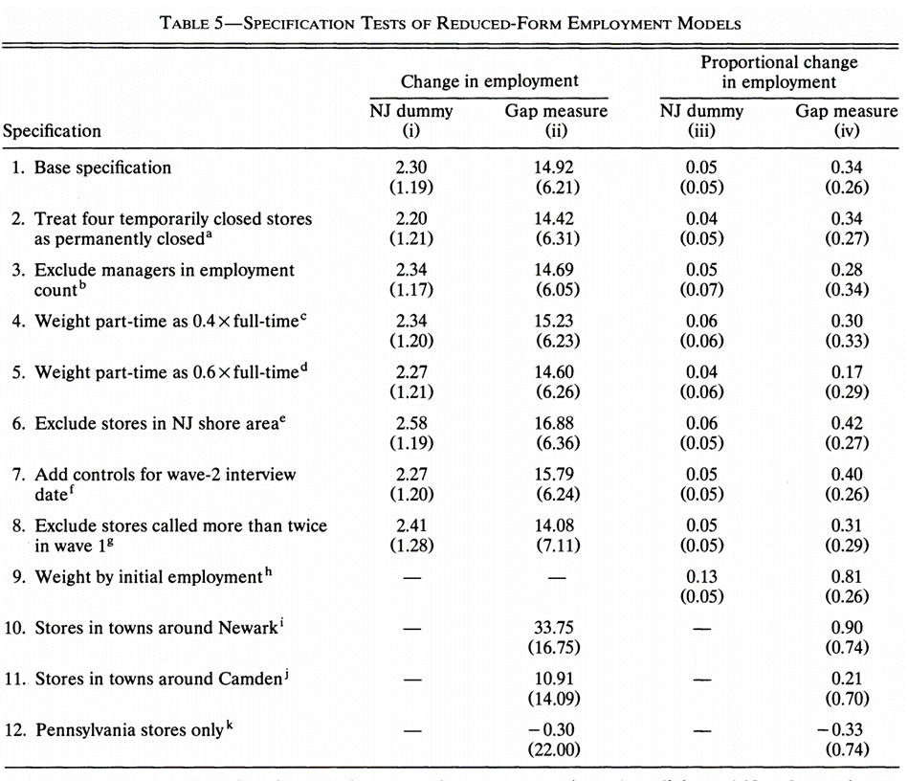
Employment change
Employment in NJ increased 2.76 workers on average compared with PA
Positive impacts of the minimum wage on employment
Robustness
check

Slide 9
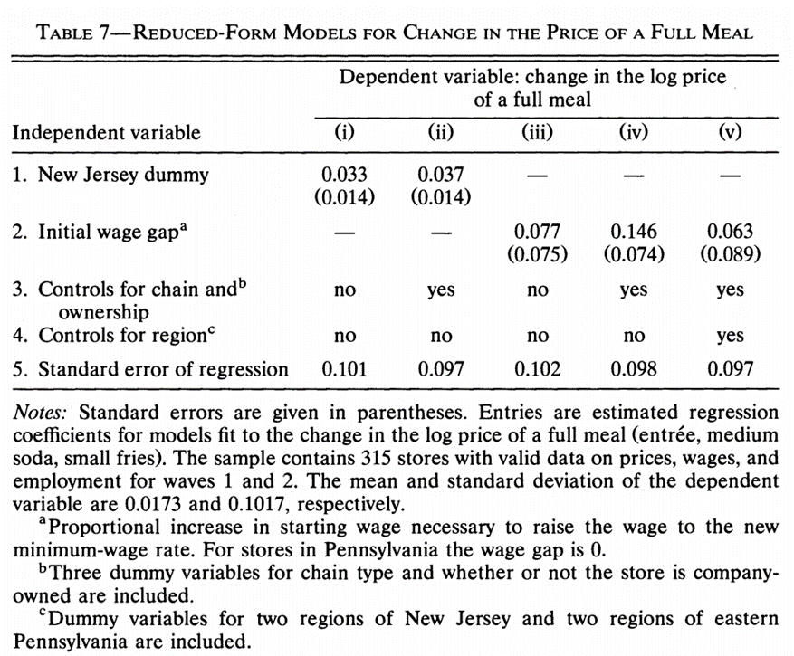
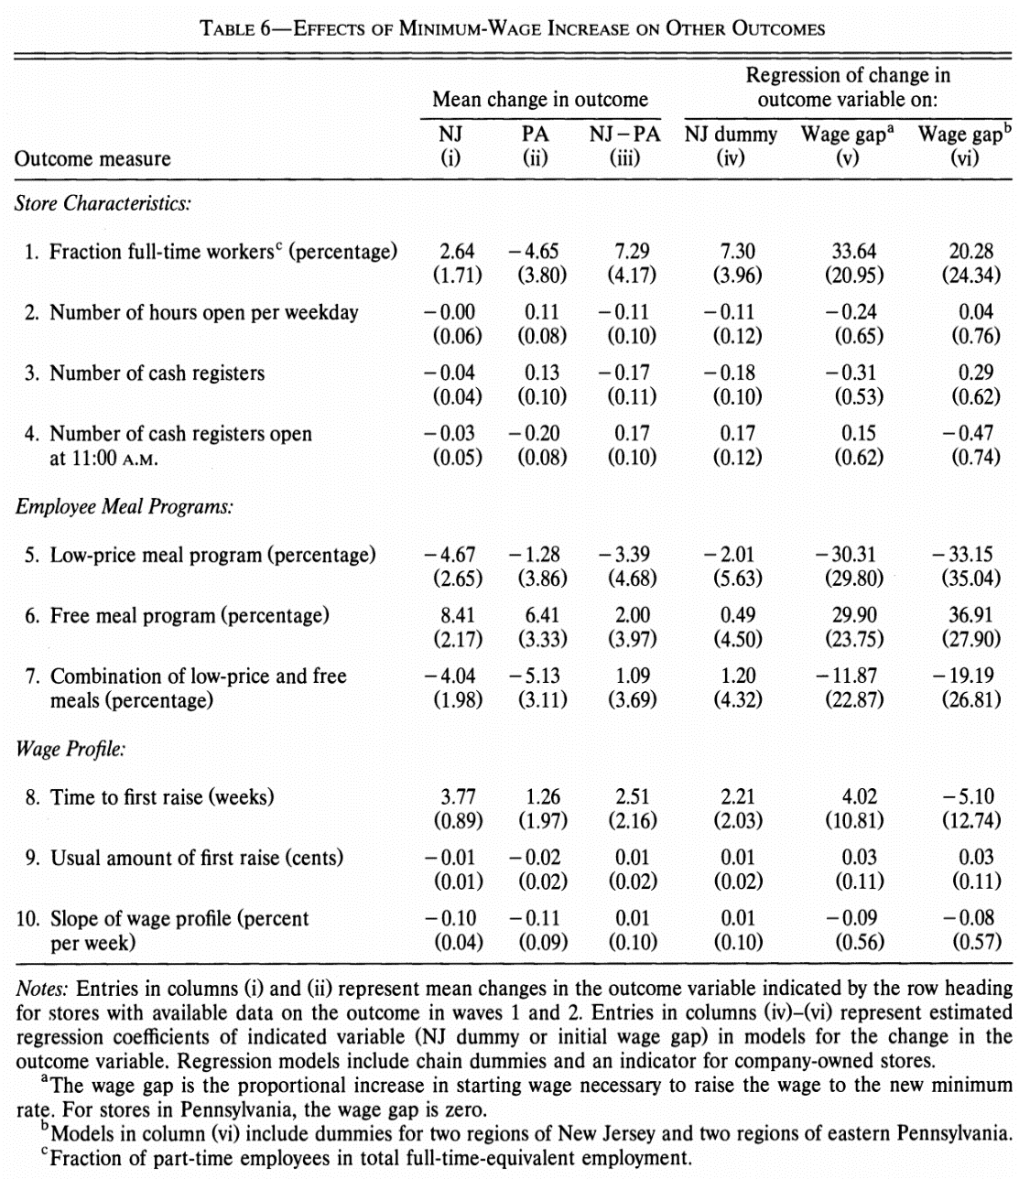
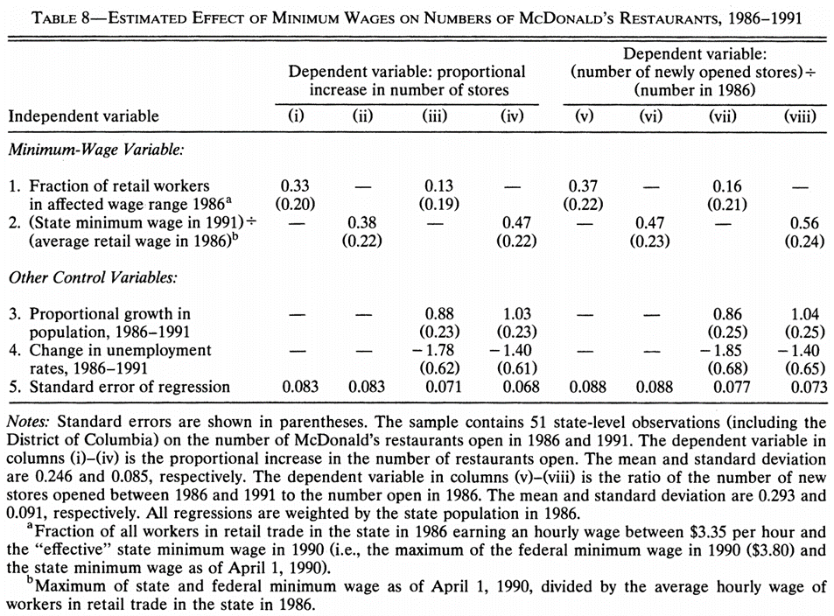
Nonwage offsets
Minimum wage
Price of a full meal

Slide 10
Reflection of Methodology: Strengths
The results are reliable (consistent with the analysis of BLS ES-202 data).
Identifies the problem: Does the increased employment benefit from the increased minimum wage or merely the improvement of economic conditions?
Card & Krueger found that employment of teenage in NJ drops slower than the other areas of the US under the same economic conditions.
Robustness check using alternative models confirms hypothesis – minimum wage increase does not decrease employment
Wage variation in NJ before the wage increase allowed Card and Krueger to compare high wage and low wage chain restaurants within NJ.
Before increase - Employees in different parts of NJ earned $5.00 an hour (above average)

Slide 11
Reflection of Methodology: Limitations
The results of DID in investigating policies influences could be complex since the final results could be a combination of multiple positive and negative effects.
The final results could be totally different when using different data source. For example, data of McDonald's (around 50% market share) were not collected in the survey data.
Short-term effects? Or long-term effects? Restaurant industry chain may not be able to reflect (close store or downsizing in a short term).
Minimum wage increase → The poor increase their consumption of fast food → Employment of fast food restaurant increase. It could be a reason of the increased minimum wage positive effects on employment.

Slide 12
Calls into questions of the study:
David Neumark & William Washcher. “Minimum Wages and Employment: A Case Study of the Fast-Food Industry in New Jersey and Pennsylvania: Comment.” American Economic Review, December 2000, 90(5), pp. 1362-96.
Telephone interview data
Reply: By using Bureau of Labor Statistic's employer-reported ES-202 data file (BLS ES-202), data were similar according to the descriptive statistics from BLS ES-202 and CK survey.
2. Excessive variance of employment in CK data may cause bias of employment change.
Reply: Variance in BLS ES-202 data was even larger.
3. Negative effects was found
Reply: Card and Kruger replicated the study using a new dataset, the positive effects was found. And they also pointed the methodology problems such as a scientific sampling method was not used in the Comment paper

